Slide 1





Sailaja Vadlamudi
^{30th} Dec
Module -4

Slide 2


Online Games

Slide 3

Online Games
Privacy Problems :- Never create usernames that are derivatives of their real names, or that might reveal any other personally identifiable information (PII), such as their location or age
Never give away any personal information and be sure to vary usernames and passwords are across different games, platforms and accounts.

Slide 4

Online Games - Empty accounts
Hidden Fees :- Never give out your card number for any freemium games.
It's a good idea to regularly check your credit card bills to make sure you're not being charged for purchases you didn't approve.
If your child is playing more traditional subscription-based games, or games that run through services like Apple or Google Play, activate the purchase password feature these providers offer in their account settings menu.

Slide 5

Online Games
Cyber Bullying - Most games allow players to "block" chat and messages from other users, and in some cases, the bully's words or actions may be a violation of the game's terms of service. It's always a good idea to write down or take a screenshot of any offensive conversation and report it to game administrators.

Slide 6
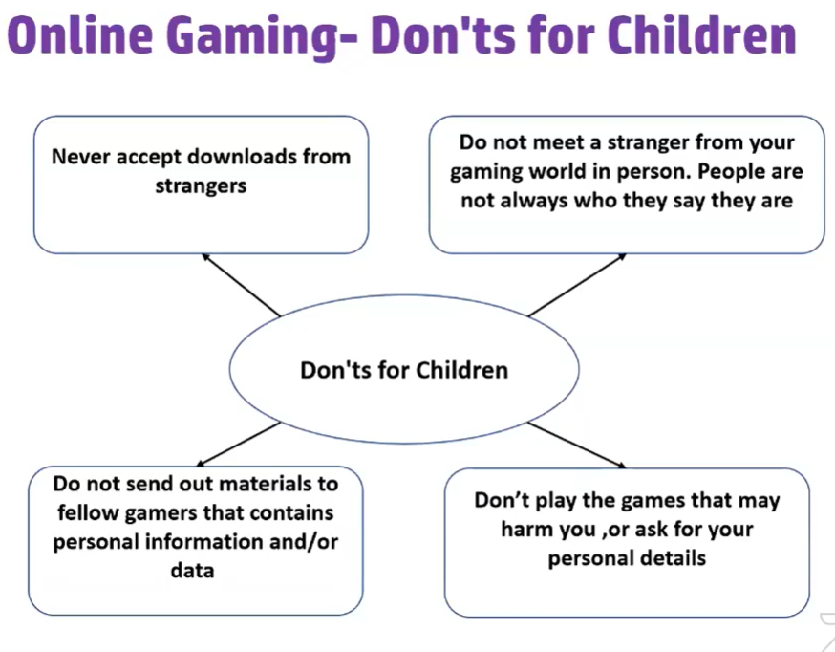

Slide 7


Slide 8
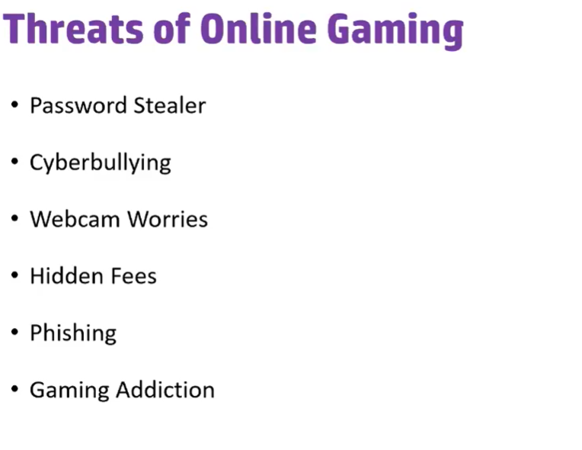

Slide 9
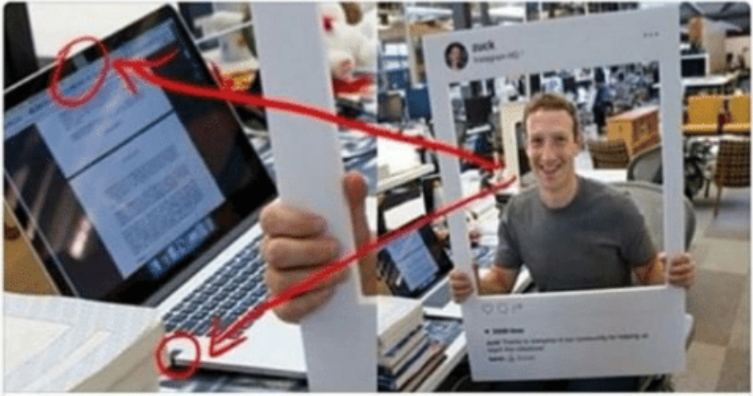
Laptop and Phone Cameras
Camera and audio jack of MacBook covered with tape

Slide 10

Laptop and Phone Cameras
Avoid phone cameras while talking to strangers

Slide 11
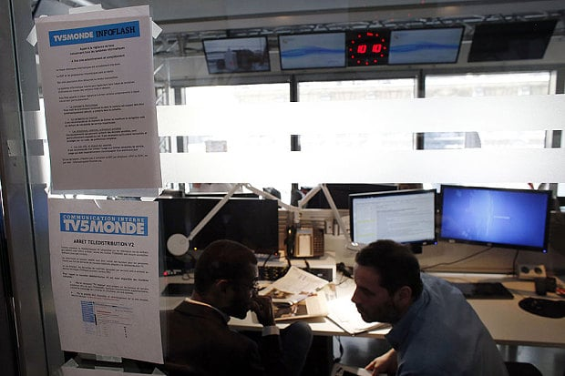
Laptop and Phone Cameras
TV5Monde unable to broadcast anything but pre-recorded programs on its 11 channels after "unprecedented" cyber attack as French government denounces "act of terrorism

Slide 12

Micro Phone
Avoid phone cameras while talking to strangers

Slide 13
C. APP STORE AND PLAY STORE:
Location
Storage
Gallery
Call logs
Contacts
Accessibility
SMS
Camera
Mic
Dangerous
Permissions – is the key for downloading apps

Slide 14
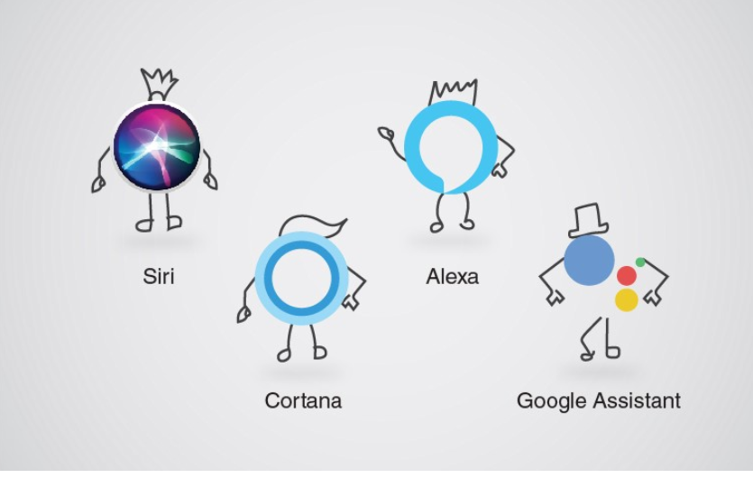
Digital Assistants
Apple apologizes for allowing workers to listen to Siri recordings
Google has paused the program in Europe after a leak of recordings, and pledged to review its safeguards
Microsoft did not change it program, listening to its Cortana voice assistant but also to Skype conversations it updated its privacy policy
Amazon Echo’s privacy issues go way beyond voice recordings

Slide 15

Juice Jacking – Public USB Port Phone Charging
60-second power-up good enough to compromise phone’s data.

Slide 16




Sharing photos with Strangers

Slide 17
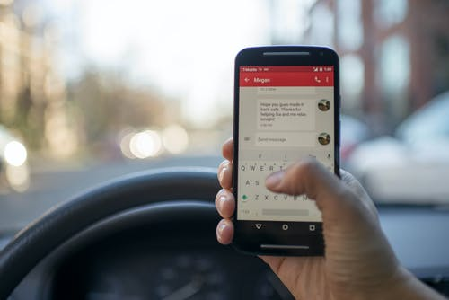
Places where you find threats
Instant Messages and Chat

Slide 18

Places where you find threats
Email is very familiar so it id very popular for different types of Scams

Slide 19

Places where you find threats
Software Downloads, email attachments contain Viruses and malwares

Slide 20

Places where you find threats
Get into trouble if you download pirated or copyrighted music , movies, tv shows or software

Slide 21

Places where you find threats
We share every bit to strangers on train journey ….
Limit Information Sharing

Slide 22
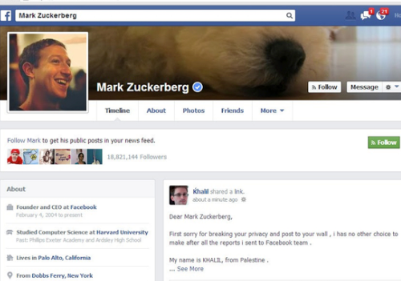

Having same passwords for all accounts
Zuckerberg’s weakness was reusing passwords “dadada”

Slide 23


Never respond to a threatening email, message, post, or text.

Slide 24
Thank You

Slide 25

CYBER LAWS- IMPLICATIONS OF FLOUTING THE LAW
The computer-generated world of the internet is known as cyberspace and the laws prevailing in this area are known as Cyber laws and all the users of this space come under the ambit of these laws as it carries a kind of worldwide jurisdiction. Cyber law can also be described as that branch of law that deals with legal issues related to use of inter-networked information technology. In short, cyber law is the law governing computers and the internet.Cyber law is important because it touches almost all aspects of transactions and activities and involves the internet, World Wide Web and cyberspace. Every action and reaction in cyberspace has some legal and cyber legal angles.

Slide 26

CYBER LAWS- IMPLICATIONS OF FLOUTING THE LAW
1. Need of Cyber Laws-
The world is becoming more and more digitally sophisticated and so are the crimes. The Internet was initially developed as a research and information sharing tool and was in an unregulated manner. As the time passed by it became more transactional with e-business, e-commerce, e-governance and e-procurement etc. All legal issues related to internet crime are dealt with through cyber laws. As the number of internet users is on the rise, the need for cyber laws and their application has also gathered great momentum.
2. Punishment for Breaking the Cyber Laws and Committing the Cybercrimes-
Punishment is three years imprisonment or fine of one lakh rupees or both. 66D Cheating by personation using computer resources or a communication device shall be punished with imprisonment of either description for a term which extends to three years and shall also be liable to fine which may extend to one lakh rupee.

Slide 27

New technologies and high-speed internet connections have helped online gaming become a popular pastime on the internet. Because gamers invest large amounts of time and money in today’s sophisticated games, others see an opportunity for mischief or illicit profit. The technological and social risks of online games should be understood by anyone who enjoys them. These include the following:
● risks from social interactions with strangers who may trick you into revealing personal or financial information.
● risks from computer intruders exploiting security vulnerabilities.
● risks from online and real-world predators .
● risks from viruses, Trojan horses, computer worms, and spyware Online gambling is now also very popular.
People play casino-like games, lotteries, and bet on sporting events.Like any form of gambling, the risks include addiction and the potential rapid loss of any funds invested in the game.
ONLINE GAMING-
SAFETY AND SECURITY

Slide 28
Online Gaming Risks
Gamers sell virtual game items for real-world money in markets such as eBay. In some games, there is a user-created, virtual world where people use real money to create or purchase personal property in their online world. This has created an opportunity for a new type of criminal activity called “virtual crime.”
In general, online gaming may involve both social risks and technological risks. Thus, many online gaming risks are similar to those computer users may have already encountered, but they may not have realized that the games pose another opportunity for the compromise of their privacy or computer security.
1. Technological Risks.
Online gaming can involve the following technological risks to your computer system or the systems of gamers with whom you interact.
● Viruses and Worms
● Malicious Software
● Insecure or Compromised Gamer Servers
● Insecure Game Coding
ONLINE GAMING-
SAFETY AND SECURITY

Slide 29
Online Gaming Risks
2. Social Risks.
Although computer games were once solitary activities, most now have an online community that talks, chats, or sends instant messages during the games. Some computer intruders may use the social interaction of the online gaming environment in an attempt to exploit software vulnerabilities. Others may try to gain access to unprotected computers connected to the internet. The intruders may want to do any of these:
● capture your personal information
● steal your identity
● steal credit your card information
● inappropriately contact children by pretending to be another child, setting up meetings, or tricking them into revealing personal information
The following lists the various social risks associated with Online Gaming:
● Social Engineering
● Virtual Mugging
● Virtual sweetshop
● Cyber Prostitution
● Protection Schemes
● Identity Theft
ONLINE GAMING-
SAFETY AND SECURITY

Slide 30
Online Gaming Risks
2. How to Prevent against such risks?
Internet gaming can be a safe and enjoyable online activity if you educate yourself and practice the basic principles of good computer security. Key practices of good personal computer security include the following:
● Use antivirus and antispyware programs.
● Be cautious about opening files attached to email messages or instant messages.
● Verify the authenticity and security of downloaded files and new software.
● Configure your web browsers securely.
● Use a firewall.
● Identify and back up your personal or financial data.
● Create and use strong passwords.
● Patch and update your application software.
ONLINE GAMING-
SAFETY AND SECURITY

Slide 31

VARIOUS TYPES OF ONLINE SCAMS, FRAUDS AND SHOPPING SCHEMES
Internet scams are different methodologies of Fraud, facilitated by cybercriminals on the Internet. Scams can happen in a myriad of ways- via phishing emails, social media, SMS messages on your mobile phone, fake tech support phone calls, scareware and more. The main purpose of these types of scams can range from credit card theft, capturing user login and password credentials and even identity theft.

Slide 32
1. Phishing email scam
2. Online Shopping Frauds
3. Identity theft
4. Work From home Scam
5. Lottery Frauds
6. Online Matrimony Fraud
7. Tax Scams
8. Credit Card Points Fraud
9. Social Media Frauds
10. Olx Fraud
● How to protect yourself from such frauds?
➢ Know the Scams
➢ Activate Pop up Blocker
➢ Scan Your Computer from spyware regularly
➢ Do no respond to spam emails or click on phishing links
➢ Avoid downloading from unknown sources
➢ Keep antivirus Up to date.
VARIOUS TYPES OF ONLINE SCAMS, FRAUDS AND SHOPPING SCHEMES

Slide 33
REPORTING AND PREVENTION OF SUCH INCIDENTS
With the exponentially growing rate of cyber crime, the Crime investigation team has been establishing many cyber cells in different parts of India, making it unchallenging and secure for the victims to file complaints with minimum hassle. These cyber crime cells look into the reporting and investigation of cyber crimes. Complaints can be made at any time to the cyber police or cyber crime cell of any jurisdiction, either offline or online. As per IT Act,2008, cyber crimes are covered under the purview of global jurisdiction which means that cyber crime complaints can be registered from any part of the country and with any crime cell irrespective of its place of commitment. Here we will be discussing the various methods of filing cyber complaints.

Slide 34
REPORTING AND PREVENTION OF SUCH INCIDENTS
1.Complaint in Cyber Cell
● Register a written complaint with the cyber crime cell of the city addressing the Head of the Cyber Crime cell of the city.
● Provide details like, your Name, address, contact details for further communication and following up. Additionally, certain documents may also be asked, which will depend upon the nature of crime.
● In case of Online Harassment. Legal counsel can also be approached to assist in reporting of crime.

Slide 35
REPORTING AND PREVENTION OF SUCH INCIDENTS
2. Complaint in the form of FIR
If one does not have access to any of the cyber cells in India, they can file a First Information Report (FIR) at the local police station. Many cyber offences also come under the provision of IPC and most of these crimes are classified as cognizable offences. As per Section 154 of Code of criminal procedure, it is mandatory for every police officer to register a complaint irrespective of jurisdiction in which crime was committed. He must later forward it to the police station under whose jurisdiction the crime was committed.

Slide 36
REPORTING AND PREVENTION OF SUCH INCIDENTS
3. Registering and Online Cyber Crime Complaint
The Cyber Crime Cell of Delhi Police and Indore have already launched an online portal for educating the masses on cyber crimes and also accepting online cyber crime complaints. Following are the links to file a cyber crime complaint in India through an online portal:
●https://cybercrime.gov.in/Accept.aspx
●http://www.cybercelldelhi.in/
●http://www.indorepolice.org/cyber-crime.php

Slide 37
REPORTING AND PREVENTION OF SUCH INCIDENTS
4. Ncpcr (National Commission for Protection of Child Rights)
https://www.ncpcr.gov.in
Log into the POCSO E-box .The National Commission for the Protection of Child Rights (NCPCR) set up this online portal to receive complaints regarding sexual abuse and related offences. A child or an adult on his or her behalf can locate the POCSO e-box at the NCPCR site.

Slide 38
REPORTING AND PREVENTION OF SUCH INCIDENTS
5. Childline 1098
CHILDLINE 1098 is India’s first 24-hour, free, emergency phone service for children in need of aid and assistance. A child or any adult on his or her behalf can dial 1098, the toll free number to seek help for emergency needs and to avail of long-term care and rehabilitation services.

